Slide 1

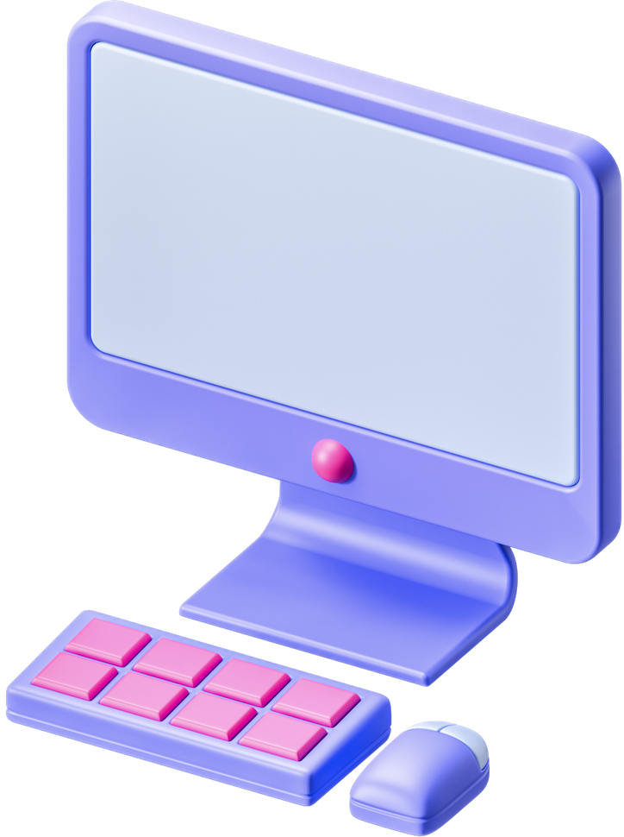

CLOUD COMPUTING

Slide 2
TEAM MEMBERS
Ashwin Menon
Athul S
Fazal S
N Shibil Shan

Slide 3

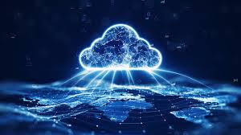

WHAT IS CLOUD COMPUTING
Cloud Computing refers to manipulating,configuring, and accessing the applications online.It offers online data storage, infrastructure and application. Cloud Computing is both a combination of software and hardware based computing resources delivered as a network service.

Slide 4
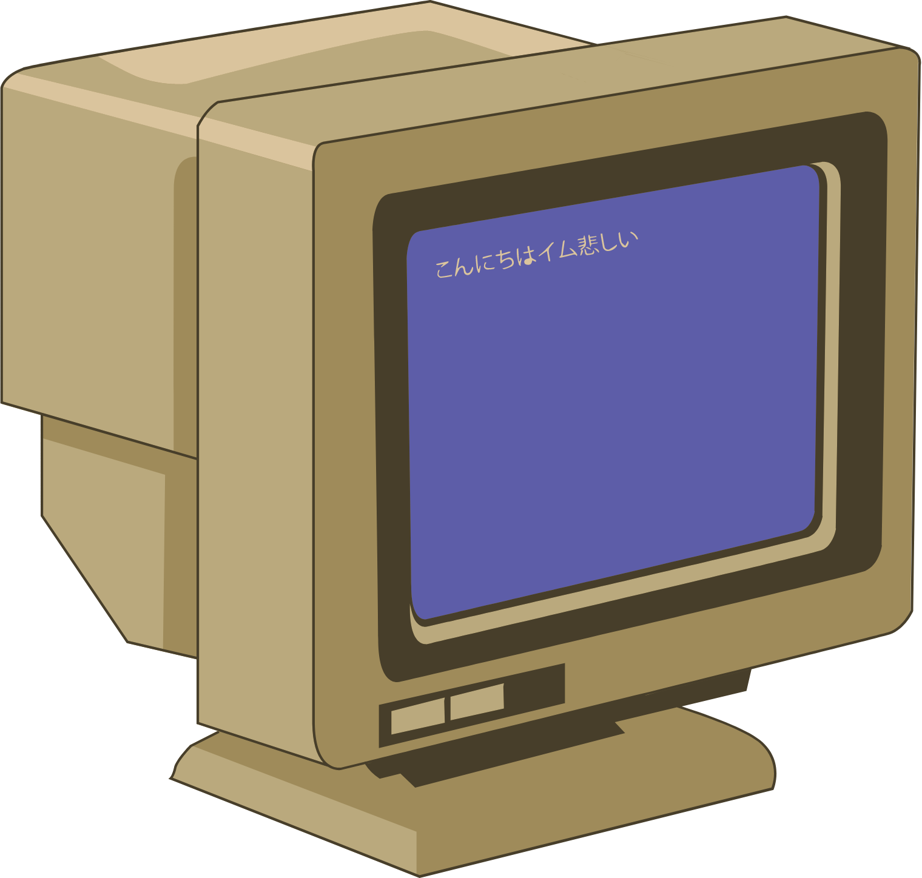
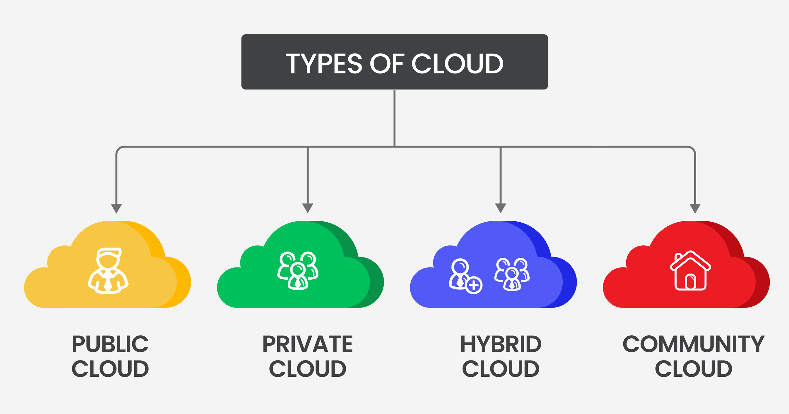

TYPES OF CLOUD COMPUTING
PUBLIC CLOUD
PRIVATE CLOUD
HYBRID CLOUD
COMMUNITY CLOUD

Slide 5
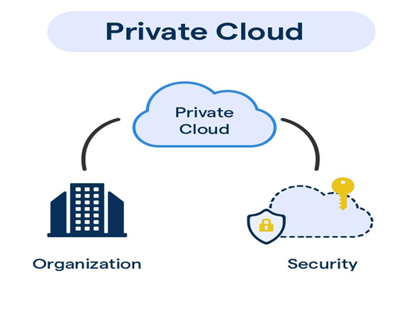
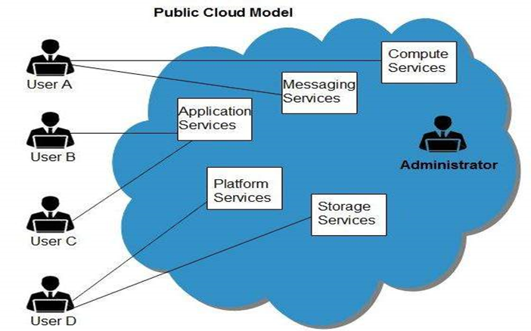
PUBLIC CLOUD
PRIVATE CLOUD
The Public Cloud allows systems and services to be easily accessible to the general public. Public cloud may be less secure because
of its openness, e.g., e-mail.
The Private Cloud allows systems and services to be accessible within an organization. It offers increased security because of its private nature

Slide 6
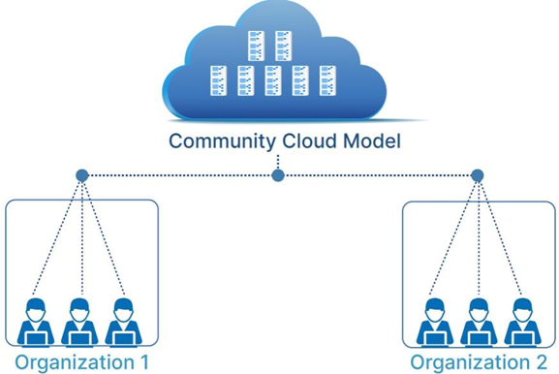
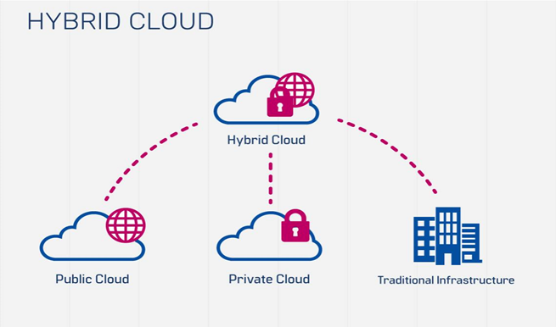
Hybrid cloud
Community cloud
The Hybrid Cloud is mixture of public and private cloud. However, the critical activities are performed using private cloud while
the non-critical activities are performed using public cloud.
AThe Community Cloud allows systems and
services to be accessible by group of organizations.

Slide 7
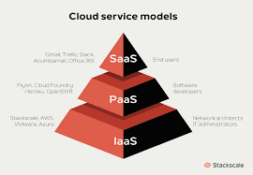
SERVICE MODELS
Software as a service
Infrastructure as a service
Platform as a service

Slide 8
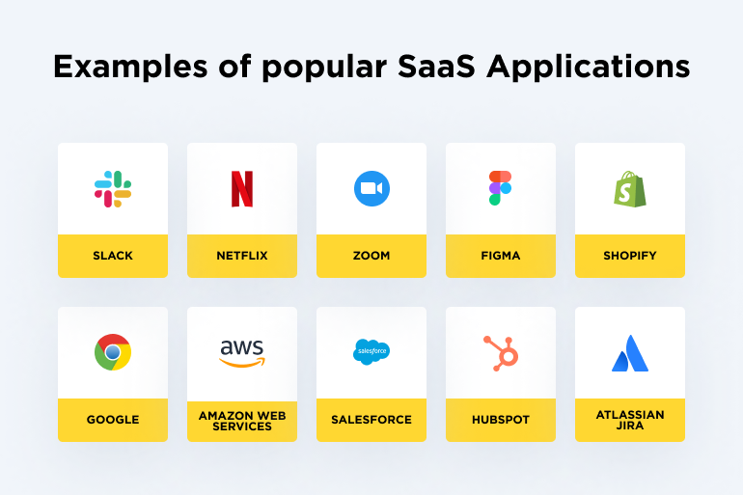
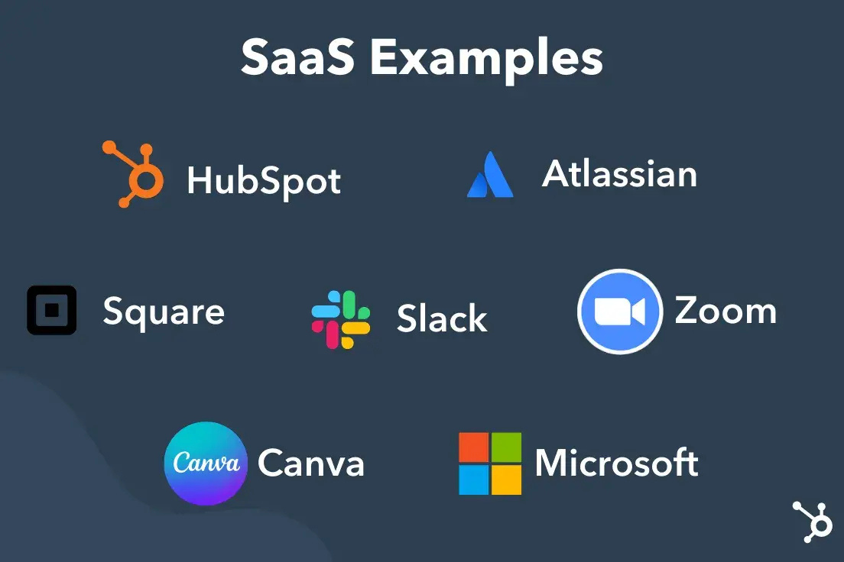
Software as a Service(SaaS)
is a way of delivering services and applications over the Internet. Instead of installing and maintaining software, we simply access it via the Internet, freeing ourselves from the complex software and hardware management. It removes the need to install and run applications on our own computers or in the data centers eliminating the expenses of hardware as well as software maintenance.

Slide 9
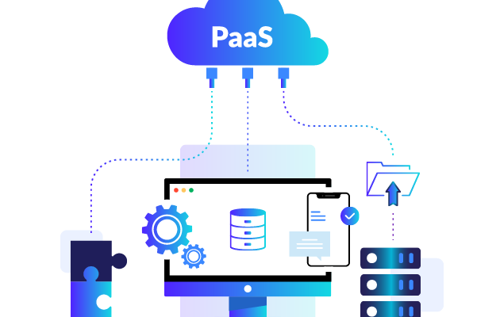
Platform as a Service
Paas provides the runtime enviorment for applications
paas provides all of the facilities required to support the complete life cycle of building and delivering web applications and services entirely from the internet

Slide 10
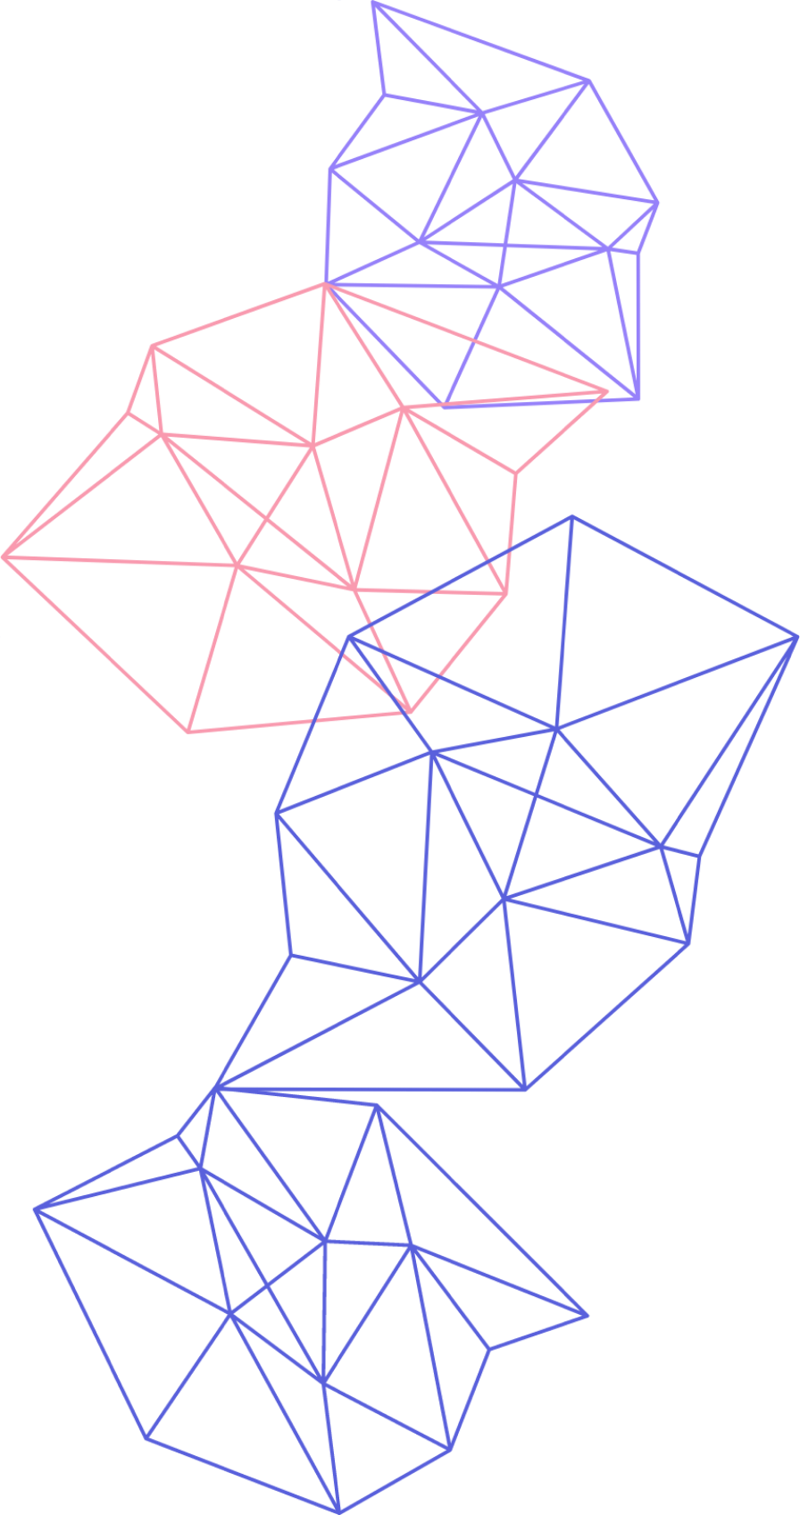
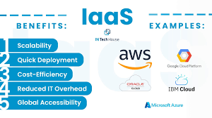
Infrastructure as a Service (IaaS)
IaaS is the delivery of technology infrastructure as an on demand scalable service
IaaS provides access to fundamental resources such as
physical machines, virtual machines, virtual storage, etc.
Usually billed based on usage
Can be coupled with Managed Services for OS and
application support

Slide 11
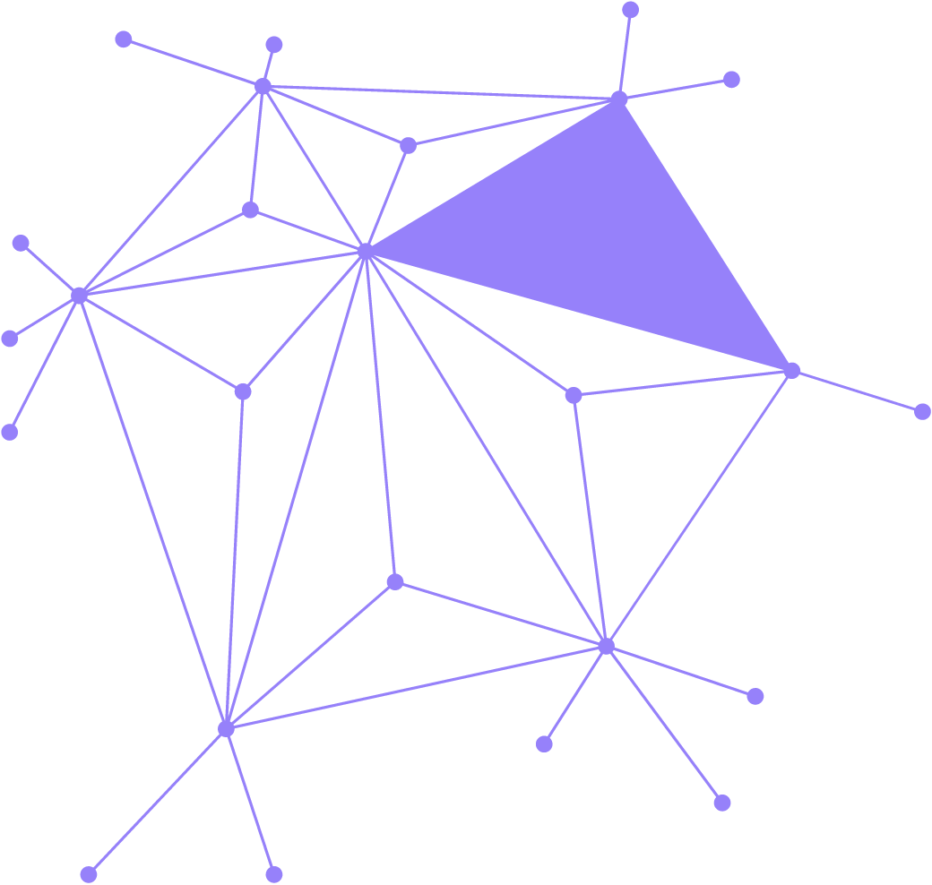
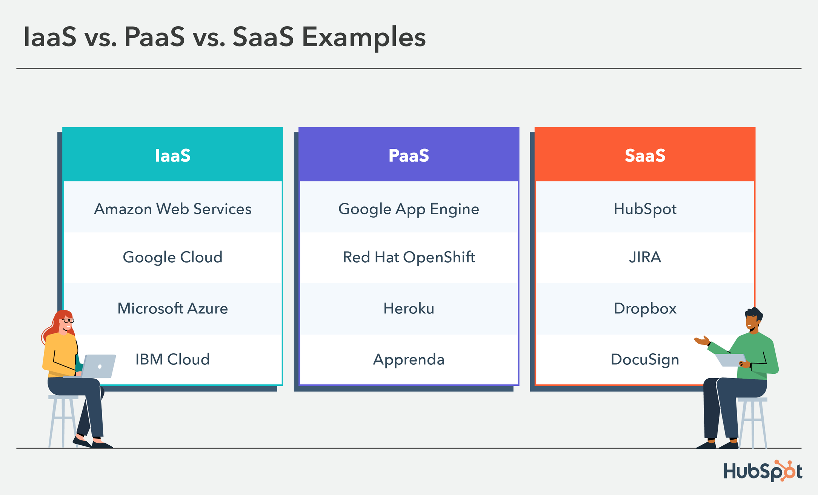
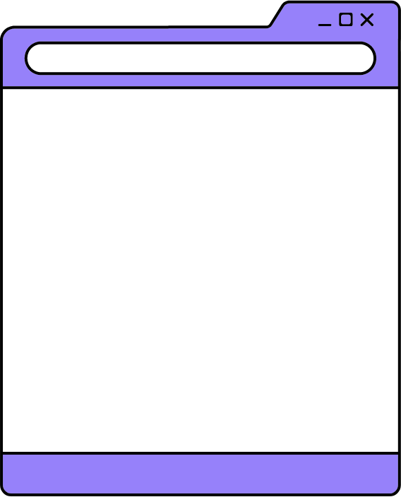
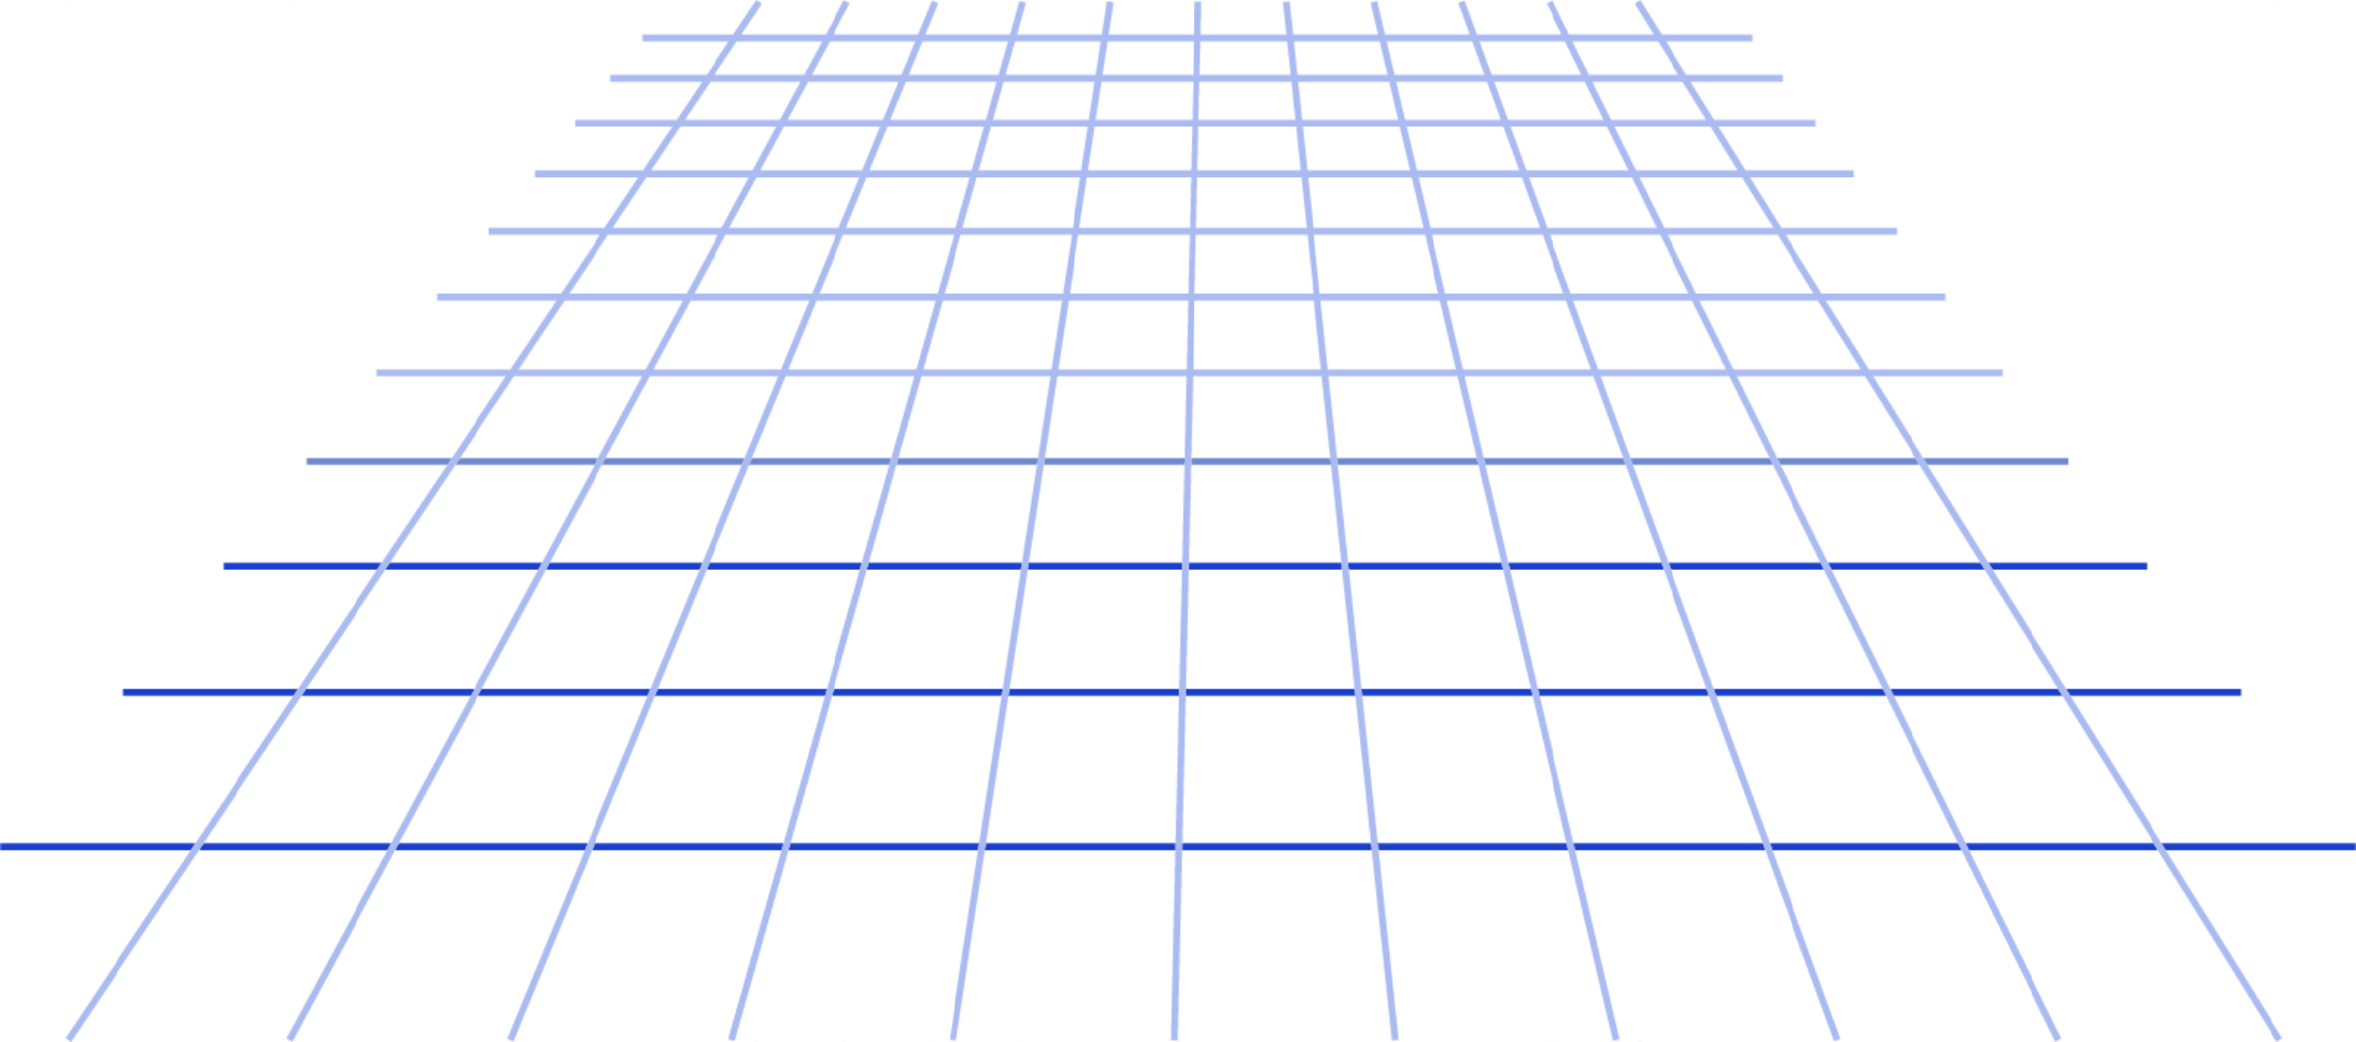

Slide 12
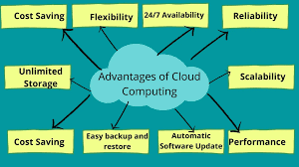
ADVANTAGES
•Lower computer costs
Advanced security
Reduced software cost
Improved performance
•Improved document format compatibility

Slide 13
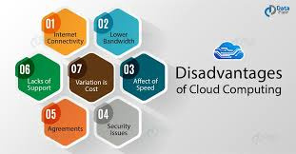
DISADVANTAGES
cost concerns
•Stored data might not be secure
Requires a constant Internet connection
•Features might be limited
•Stored data can be lost

Slide 14
CONCLUSION
Cloud computing has quickly become one of the most prominent buzzwords in the IT world due to its revolutionary model of computing as
a utility. It promises increased flexibility, scalability, and reliability, while promising decreased operational and support costs
Conclusion. Cloud computing is a fantastic platform that offers servers, storage, and applications helpful for managing the business in a secure way from anywhere in the world. It requires a good internet connection to offer highly secure cost-effective, and scalable resources.

Slide 15
THANK YOU

